Slide 1
Comprehensive Digital Marketing
Project Work

Slide 2
Students will be divided into 50 groups each having an individual brand name and within this would be 9 students each
Lakmé
Allen Solly
Apollo Hospitals
VLCC
Fortis healthcare institute
Fabindia
Forest Essentials
Flying Machine
Himalaya Herbals
Bata
John Players
Khadi Naturals
Louis Philippe
Liberty
Juicy Chemistry
Paragon
Peter England
Biotique
Red Tape
Britannia
Mother Dairy
Tech Mahindra
Axis Bank
Amul
Wipro
Parle Agro
Tech Mahindra
McCain
ICICI Bank
Kissan
MTR Foods
Sun feast
HDFC Bank
HRX
Yes Bank
Cadbury
Haldiram’s
Balaji Telefilms
Digit Insurance
Life Insurance Corporation Of India
Bajaj Electricals
Havells India Ltd.
Videocon Industries Limited
Crompton Greaves Consumer Electricals
Tata Motors
Maruti Suzuki India Ltd
Mahindra & Mahindra Ltd
Hero MotoCorp Ltd
Ashok Leyland Ltd
Apollo Tyres

Slide 3


Slide 4
GROUP MEMBERS
AMANDA MURIAL KIRK ( Team leader )
J. BEULAH PRAISE
TEJASWITA TIWARI
KASI BHARATHI
LACHUBOTULA RAJESH

Slide 5

Part 1 : Brand study , Competitor analysis & Buyer’s / Audience’s Persona .
Topic of the Project : CADBURY
Research Brand Identity : Study the brand’s mission , values , vision , and unique selling propositions (USP)
Brand colors : Purple , white .
B. Logo :
C . Mission , vision and values :Cadbury’s vision , mission is ‘QUALITY’ it is they promise . They entire reputation is built on quality . They are always committed to improvement which ensures that they promise is delivered . They are five core values which are QUALITY, INTEGRITY, RESPECT , RESPONSIBILITY AND JOY .

Slide 6
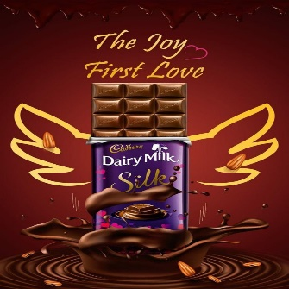
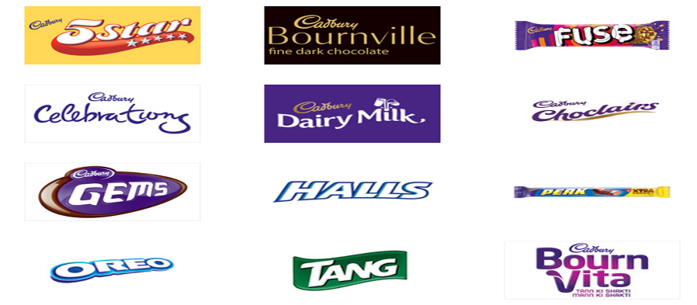
D. Unique Selling Proposition (USP) : The unique selling proposition of Cadbury is they unique taste . The company is known for using high quality ingredients to create its signature rich and creamy chocolate taste .
E . Product Range : Cadbury dairy milk , dairy milk silk , gems , temptations , celebrations , halls , tang , oreo , boost , bourn vita , 5 star , perk .
F . Tagline : “ TASTE LIKE THIS FEELS” .

Slide 7
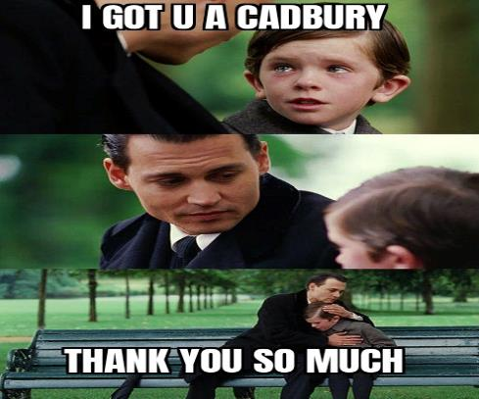
G . Brand Message : Urges people to treat and embrace others happiness
and achievements with a great heart .

Slide 8
Part 1: Brand study, Competitor Analysis & Buyer’s/Audience’s Persona
Analyze Brand Messaging : Brand Messaging is the way a brand communicates , its unique value proposition (USP) and personality through its verbal and non verbal messaging . The message a brand spreads can inspire and motivate the customers making them want to buy they product . Its builds a relationship between the consumer and brand .
The brand “ CADBURY” spreads the message of ‘GENEROSITY’
With the underlying message – “ THERE’S A GENEROUS INSTINCT WITHIN EVERYONE’ . Cadbury always encourages sharing , celebration , richness and quality through its brand . The main purpose of the brand is to spread happiness and joy . The main reason for Cadbury to have so many loyal customers is because of its strong brand message , uniqueness and no compromise in quality , texture and taste . The is no age bar to have a Cadbury .

Slide 9
Examine The Brand’s Tagline : In the context of branding , a tagline is a memorable motto or phrase that’s designed to serve as a permanent expression of your company’s greater purpose and mission .
The tagline for Cadbury India – “ Kuchh Achha Ho Jaaye ,
Kuchh Meetha Ho Jaaye” . It is aimed at building strong brand equity and emotional connect for the brand . The tagline also marks Cadbury’s 70th anniversary of its presence in India and is a renovation of its original ‘Kuchh
Meetha Ho Jaaye’ campaign . This tagline is exclusively for Cadbury dairy milk and not all the products of Cadbury . Each product that comes under Cadbury has its own tagline . For example :1) The tagline of Cadbury 5 star - “Eat 5 – star , Do Nothing” . 2)The tagline for Cadbury Bournville – “ You dont buy a bournville you earn it” . 3) The tagline for Cadbury gems in India is
“ Raho umarless” . A good tagline should consists of 2-4 words , and absolutely no longer than 7-8 words . The tagline of a brand helps to connect
The brand to its costumers . That is the reason why Cadbury has different taglines for each products in different countries .

Slide 10

Part 1: Brand study, Competitor Analysis & Buyer’s/Audience’s Persona
Competitor Analysis : Select three competitors operating in the same industry or niche as the chosen brand , examine their USP’s and online communication .
Competitor 1 : https://www.nestle.in/
USP : For decades now , Nestle has concentrated all its efforts towards improving the nutrition , health and wellness of the society , and has been working towards enhancing the quality of life of people all around the world.
Communication : It post’s informative how to do videos , cooking tips , product insights and many more .

Slide 11


Competitor 2 : https://amul.com/
USP : The unique selling proposition of Amul is that it is India’s most trusted and popular diary products brand . It is because Amul has no middlemen it directly links the milk farmers to its consumers .
Communication : It uploads recipes , buzz among the youth , promotes products and connects with people .
Competitor 3 : https://www.hersheyland.com/home
USP : The unique selling proposition of Hershey’s is that it has a delicious , unique taste because of the farm fresh milk they use .
Communication : It uploads different new products , recipes , blogs .

Slide 12

Part 1: Brand study, Competitor Analysis & Buyer’s/Audience’s Persona
Buyer’s / Audience’s Persona : Clearly define the target audience for the
Chosen brand . Consider demographics , psychographics , behaviors and interests .
Demographics | Psychographics | Behavior | Geographics
Age | Personality | Decision Roles | Country
Gender | Values | Occasion | Religion
Location | Social class | Benefits | Metro
Education | Interests | Loyalty | Village
Income | Life styles | Attitude | Language

Slide 13
Demographics : The following are the demographics that have to
be taken care of by Cadbury in terms of their customers
Age – 3 years and above .
Gender – Male and Female
Location – Metro cities like Mumbai and Delhi
Education – Basic
Income – Average
Psychographics : The following are the psychographics that have to be taken care of by Cadbury in terms of their customers
Personality – Any Individual
Values – Basic human values
Social class – All classes
Interests – chocolates, confectionary items .
Life style – Any

Slide 14
Behavior : The following are the behaviors that have to be taken care
of by Cadbury in terms of their customers .
Decision Roles – Children
Occasion – no occasion required
Benefit – Easily Available
Loyalty – Absolutely Loyal
Attitude – Enthusiastic
Geographic : The following are the geographics that have to be taken care of by Cadbury in terms of customers
Country – All over the globe
Region – Available in all regions
Metro – Wide Range
Village – Not in a wide range
Language - All

Slide 15
Part 2: SEO & Keyword Research
SEO Audit: Do an SEO audit of the brands website
Keyword Research: Define Research Objectives, Brainstorm Seed Keywords, Utilize Keyword Research Tools (SEMrush or Moz Keyword Explorer),Analyze Competitor Keywords, Long-tail Keyword Exploration (specific, longer phrases) that align with the research objectives and have lower competition but higher conversion potential.
On page Optimization: Meta Tag optimization & content optimization
Reflect on the process of conducting keyword research and the SEO recommendations provided.
Document the challenges faced during the research and analysis phase, as well as the key insights gained from the keyword research process.

Slide 16
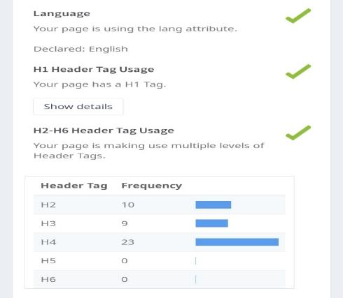
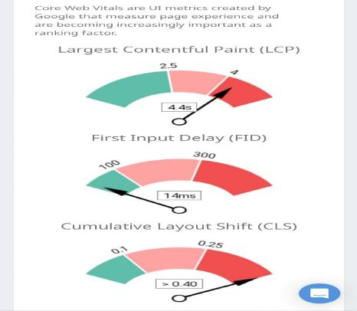
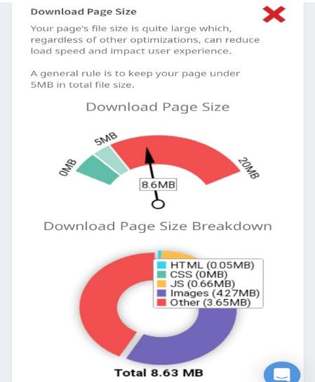
SEO Audit : The following is the search engine optimization audit for the brand Cadbury .

Slide 17
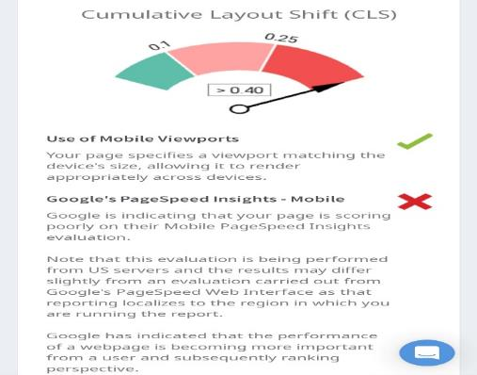
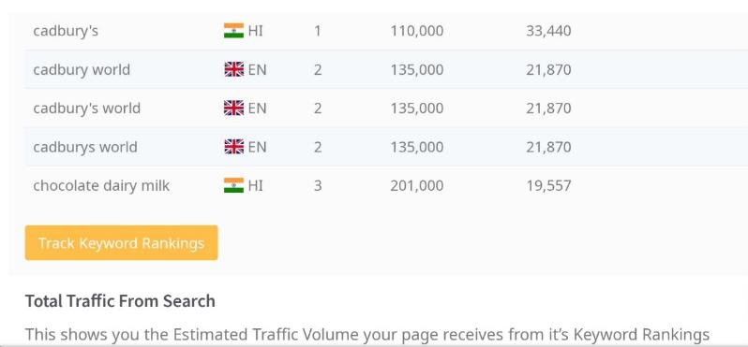
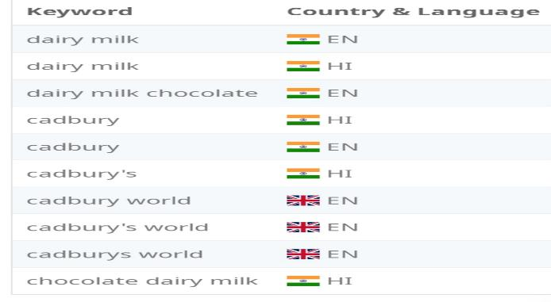
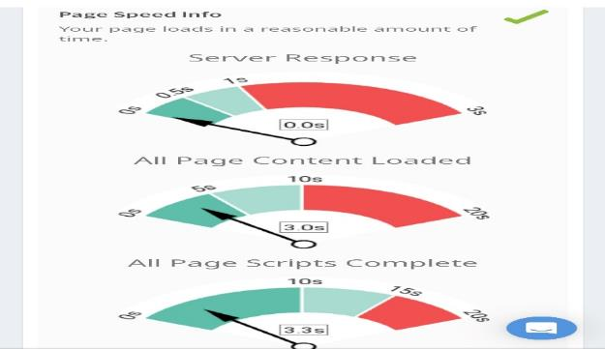

Slide 18
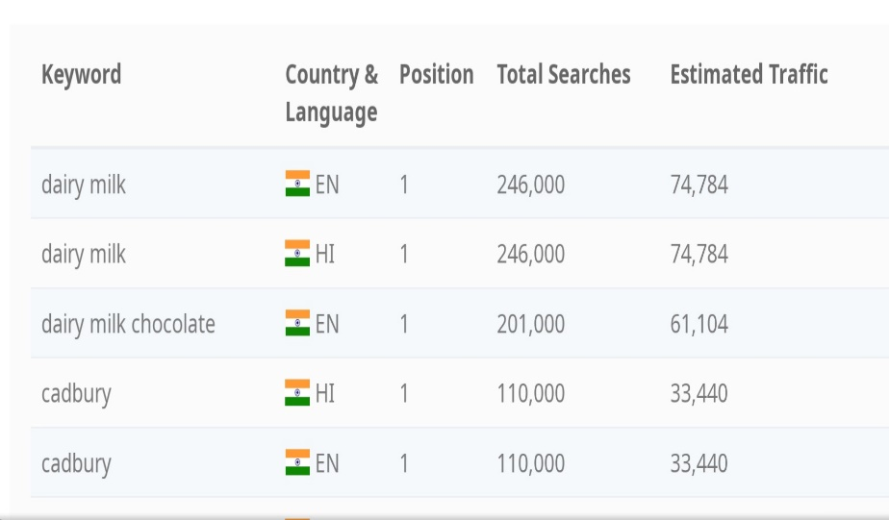
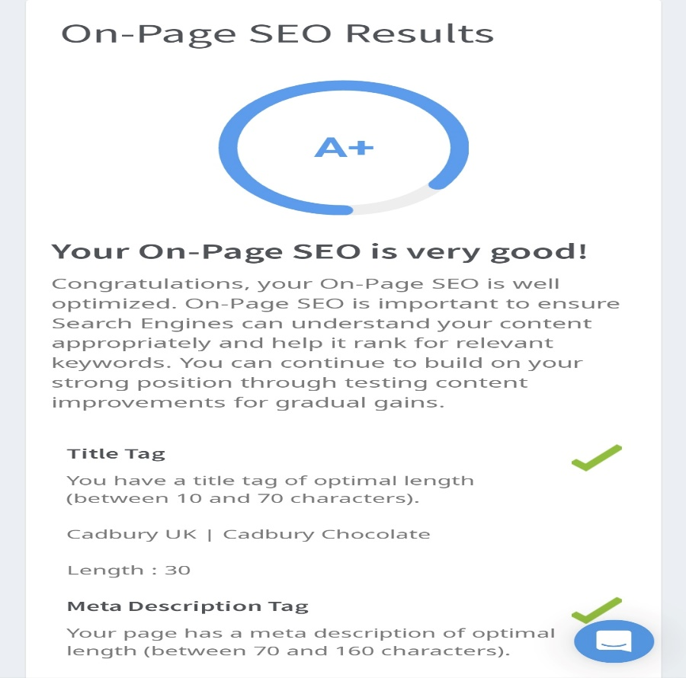
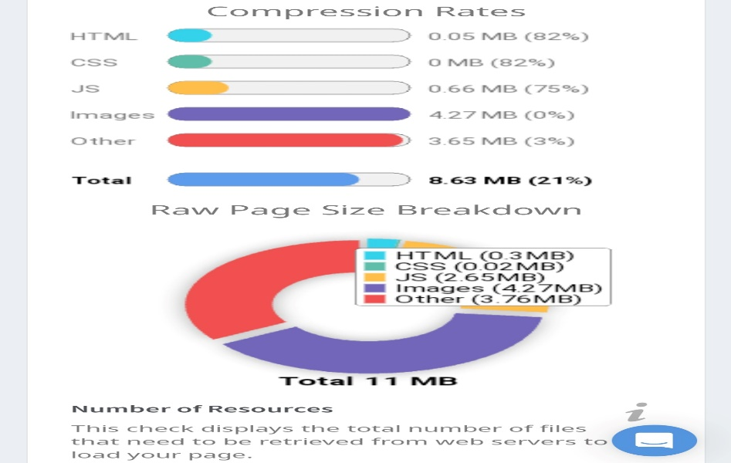

Slide 19
Key word Research : The following is the key word research for the
brand Cadbury .
Research Objectives - The following are the objectives of this research .
Understanding Cadbury’s product range and offerings .
Analyzing Cadbury’s marketing strategies and campaigns .
Investigating Cadbury’s history and milestones .
Examining Cadbury’s presence in different regions and markets .
Exploring Cadbury’s brand reputation and consumers sentiment .
2) Brain storm seed Keywords – The following are the brain storm seed key words of Cadbury .
Cadbury chocolate e) Cadbury marketing
Cadbury diary milk f) Cadbury social media
Cadbury promotions g) Cadbury consumer reviews
Cadbury competitors h) Cadbury history

Slide 20
3) Competitors key words – The following competitors key words need to be analyzed .
Nestle chocolate
Hershey’s chocolate
Mars chocolate
Ferrero Rocher
Godiva chocolates
Lindt chocolates
4) Long tail key word exploration - the following are the lond term key word explorations for the brand Cadbury .
Cadbury diary milk silk review
Cadbury marketing campaigns success
Cadbury vs Nestle chocolate comparison
Cadbury market share in the USA
Cadbury history and origin story

Slide 21
On page optimization : The following is the meta tag optimization
and content optimization for Cadbury .
5) Meta tag optimization – The following points can be used for optimizing meta tags for the brand Cadbury .
Title tag
Meta description
Meta key words
Open graph tags
Mobile optimization
Avoid key word stuffing
6 ) Content Optimization - The following points can be used for optimizing content for the brand Cadbury .
Know your audience
Highlight product benefit

Slide 22
c) Visual appeal
d) Story telling
e) Social media engagement
f) Seasonal and thematic campaigns
Reflection : The following is the reflection on the process of
conducting key word research and the SEO recommendations provided .
7) Process of conducting key word research - The following is the process of conducting key word research
Understanding business objectives
Defining target audience
Brain storming seed key words
Using key word research tools
Analyzing competitors

Slide 23
8) SEO Recommendations – The following are the SEO recommendations that are provided .
Keyword optimization
Content quality
Visual appeal
Story telling and branding
Social media engagement
Challenges and Insights : The following are the challenges faced during the research and analysis phase , as well as the insight gained .
Challenges | In sights
Data availability | User behavior and intent
Vast data | Market demand and trends
Understanding user intent | Long tail opportunities
Competitor analysis | Local SEO potential
Time and resources | Content gaps

Slide 24
Part 3: Content Ideas and Marketing Strategies
Content Idea Generation & Strategy: Create a content calendar for the remaining month of July by brainstorming content themes, exploring various formats like blog posts, videos, infographics, podcasts, and interactive quizzes, and scheduling publication dates mainly on Facebook & Instagram. And include the strategy, aim and the idea behind these posts and story
Topic : CADBURY ( Founder – John Cadbury ; 1824 London)
Aim : To promote the different products of Cadbury .
Strategy : Using social media a means of promotion { Ads , reels, videos
memes }

Slide 25
Idea : To promote he goodness of Cadbury .
AUGUST 2023
Sunday | Monday | Tuesday | Wednesday | Thursday | Friday | Saturday
30 | 31 | 1 | 2 | 3 | 4 | 5
6 | 7 | 8 | 9 | 10 | 11 | 12
 |  |  | Posted reels on Instagram
13 | 14 | 15 | 16 | 17 | 18 | 19
 | Posted a video |  |  |  |  | Posted ads on the page
20 | 21 | 22 | 23 | 24 | 25 | 26
 | Created and posted Memes
27 | 28 | 29 | 30 | 31 | 1 | 2
 |  |  | Posted an e- mail ad campaign
3 | 4 | Notes

Slide 26
Part 3: Content Ideas and Marketing Strategies
Reflect on the content ideas and marketing strategies process, discussing the challenges encountered and lessons learned.
Content Ideas : Content ideas is the process of producing or sourcing topics to be used in the future marketing content . As our topic was CADBURY it was obvious that we had to come up with content ideas that supported the brand . Cadbury had a variety of contents that they deal with the most prominent one among the is – Cadbury Diary Milk . We as a team took up SEO audits , keyword research and posts , ads , video and many more .
Marketing Strategies : Marketing Strategy is a long term plan for achieving a company’s goals by understanding the needs of the customers and creating a distinct and sustainable competitive advantage . As a team we came up with the plan of distributing our work among ourselves and choosing the platform one is good at and utilise our skills accordingly .

Slide 27
Step : 1 – Selected our topic
Step : 2 – Learned our competitors
Step : 3 – Acknowledged our strengths and weaknesses
Step : 4- Set a mission
Step : 5 – Distribution of work
Step : 6 – Follow up
Challenges Faced : As a team we faced a few challenges while doing this project in a few topics like key word research , search engine optimisation , calendar preparation and so on . Yet as a team we worked together and over came all our challenges and difficulties .
Lessons Learned : We have learned a lot about the brand, its competitors , team work and a lot about digital marketing .

Slide 28
Part 4: Content Creation and Curation (Post creations, Designs/Video Editing, Ad Campaigns over Social Media and Email Ideation and Creation)
Post Creation:
Select Content Categories: Identify three different content formats relevant to the chosen topic or industry. Research and Brainstorm: Research trending topics, industry news, or audience interests within each category. Brainstorm ideas for social media posts that align with each category. Do note that 1 content format has to be video and additionally 3 stories/status are to be created.
Format 1 : Video
Format 2 : Reel
Format 3 : Meme

Slide 29

Format 1 : Video
Aim : Boost Seo and bring aware ness about the variety of products available
in Cadbury .
Date : 14th August 2023
Idea : Cadbury has a variety of products
Topic : To bring awareness of the different products available in Cadbury.
https://www.instagram.com/reel/CvL3l42gs1N/?igshid=M2MyMzgzODVlNw==

Slide 30
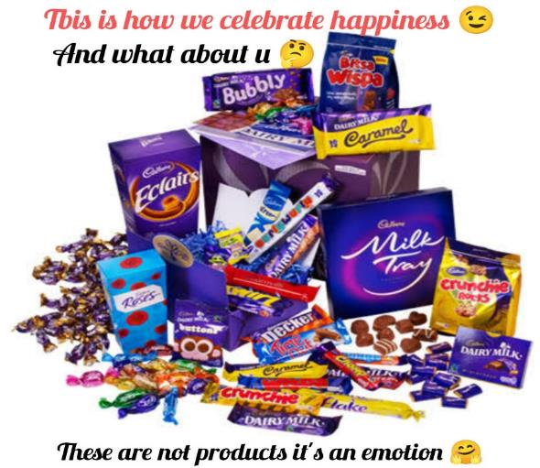
Format 2 : Ad
Aim : Promotion of Cadbury
Date : 19th August 2023
Idea : To spread the goodness of Cadbury .
Topic : Quality .
https://www.instagram.com/p/CvKlhIfybcY/?igshid=M2MyMzgzODVlNw==

Slide 31
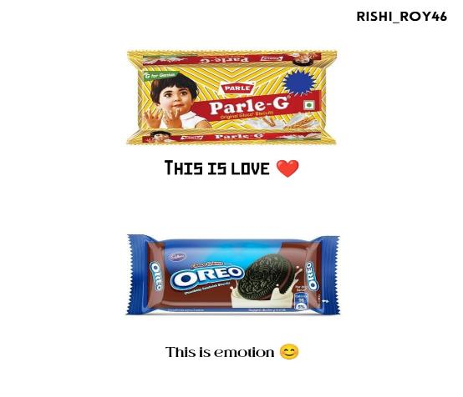
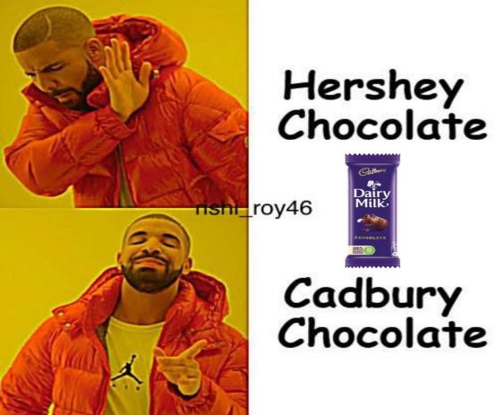
Format 3 : Meme
Aim : To overcome competitors
Date : 21st August 2023
Idea : To compare Cadbury with its competitors .
Topic : Cadbury is more than just a chocolate .

Slide 32
Part 4: Content Creation and Curation (Post creations, Designs/Video Editing, Ad Campaigns over Social Media and Email Ideation and Creation)
Instagram Story
Utilize the Stories feature on Instagram for three consecutive days. Share behind-the-scenes glimpses, polls, quizzes, or sneak peeks etc to encourage audience participation. Once uploaded use the story highlight feature on Instagram and save the 3 story with an appropriate name for each. Note: Once done monitor the performance of the posts and Stories using the insight tool and analyze the engagement metrics (likes, comments, shares, impressions, etc.). Based on the analysis, mention the strategies and areas for improvement.

Slide 33
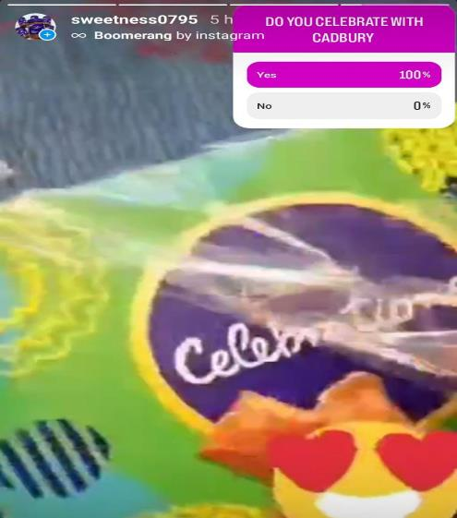
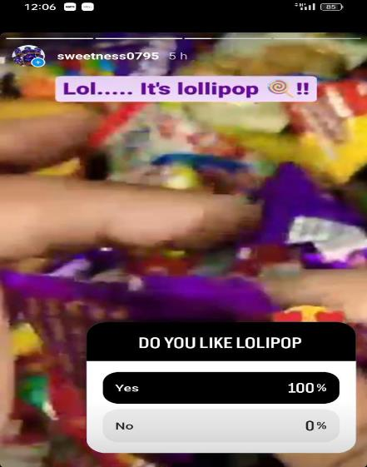
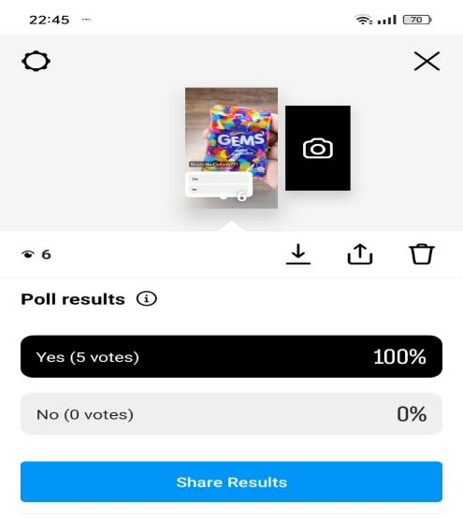
Strategies : > Areas of improvement :
Set goals 1) Increase the quality of video
Target audience 2) Maintain brand
Brand awareness 3) Attractive captions
Variety of product 4) More engagement
Enhance quality 5) regular analysis .

Slide 34
Part 4: Content Creation and Curation (Post creations, Designs/Video Editing, Ad Campaigns over Social Media and Email Ideation and Creation)
Designs/Video Editing
Design Tools Familiarization (use Canva for creating visually appealing graphics)
Video Creation: Utilize VN or any video editor of your choice to create videos related to the chosen topic.

Slide 35

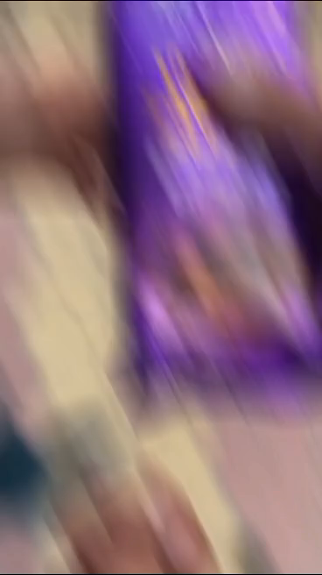


Slide 36
Part 4: Content Creation and Curation (Post creations, Designs/Video Editing, Ad Campaigns over Social Media and Email Ideation and Creation)
Social Media Ad Campaigns
Ad Campaigns over Social Media:
Come up with 3 ad campaigns each covering one of the mentioned goals: brand awareness, driving website traffic, or generating leads

Slide 37
Part 4: Content Creation and Curation (Post creations, Designs/Video Editing, Ad Campaigns over Social Media and Email Ideation and Creation)
For every campaign clearly define:
Advertising Goals: increasing brand awareness, driving website traffic, or generating leads.
Audience Targeting: Define the target audience for the ad campaigns based on demographics, interests, and behavior.
Ad Creation: Create visually appealing ad creatives, compelling ad copy and relevant call-to-action.

Slide 38
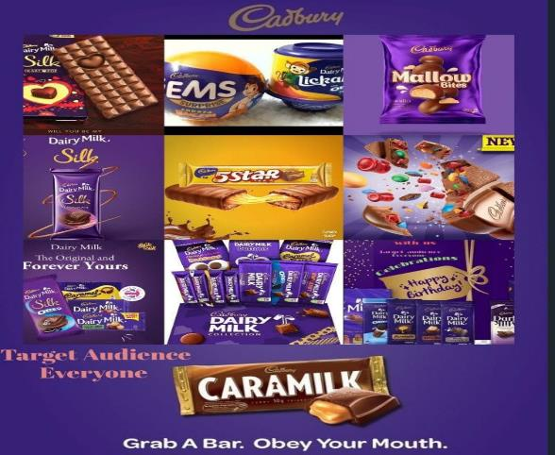
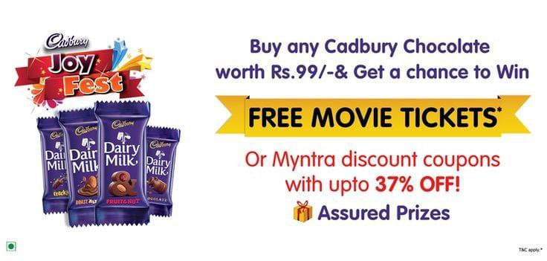
AD -1 : Ad -2 :
Advertising goal : brand awareness Advertising goal : lead generation
Target Audience : all Target : movie lovers
Ad creation : Visually appealing Ad creation : attractive
The above ad is to bring awareness The above ad is to attract all the
Of the different products in Cadbury . Customers using lead generation .

Slide 39
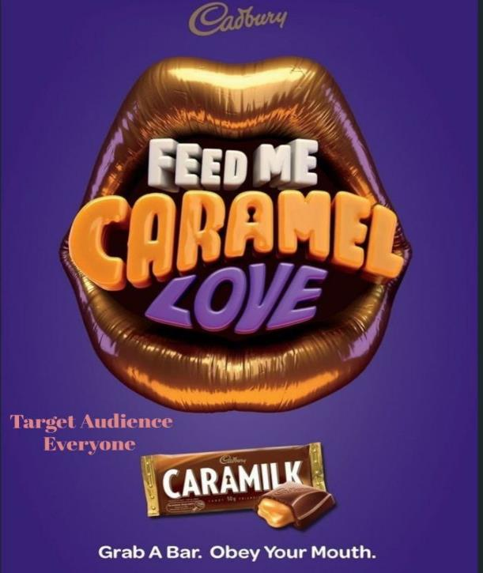
AD – 3 :
Advertising goal : website traffic
Target audience : all
Ad creation : visually appealing
The above ad is to drive website traffic
The above three ads are all posted on in Instagram in our Instagram page .

Slide 40
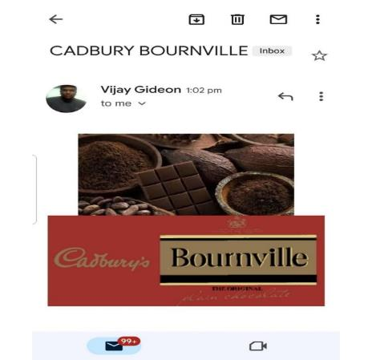
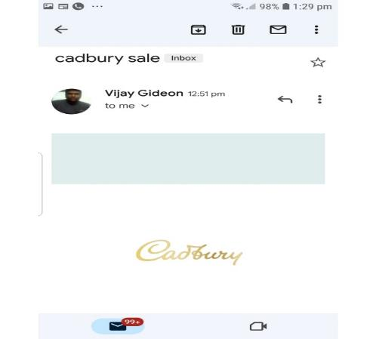
Part 4: Content Creation and Curation (Post creations, Designs/Video Editing, Ad Campaigns over Social Media and Email Ideation and Creation)
Email Ad Campaigns
Ad Campaigns for email marketing:
Come up with 2 email ad campaigns with the mentioned goals: brand awareness & generating leads

Slide 41

Email Ad Campaign 1 - Brand Awareness
( Insert emailer image )
Subject line : “ Discover Cadbury unveiling a world of magic and innovation !”
Preview : “ step into the world of wonder with Cadbury ! Discover our captivating products and experience the magic of innovation . Explore now !” .

Slide 42
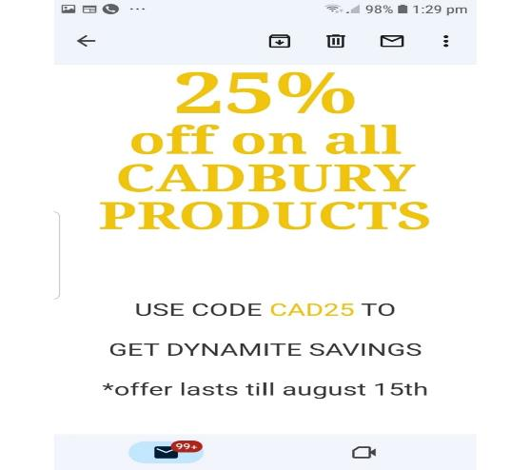
Email Ad Campaign 2 - Lead Generation
( Insert emailer image )
Subject line : “ Unlock Exclusive opportunities : claim your spot today !”
Preview text : “Get ahead of the curve ! Don’t miss out on our limited time offer . Sign up now to access exclusive benefits and stay informed with the latest insights” .

Slide 43
Part 4: Content Creation and Curation (Post creations, Designs/Video
Editing, Ad Campaigns over Social Media and Email Ideation and Creation)
Reflect on the content creation and curation process, discussing the challenges faced and lessons learned.
The following is the content creation and curation process that is followed :
Ideation viii. Analysis
Research
Creation
Editing and review
Publishing
Promotion
Engagement and interaction

Slide 44
The challenges faced : The following is the challenges faced
Creativity and originality
Time management
Audience understanding
Content quality
Content curation and credibility
Platform changes
Content promotion and visibility
Managing negative feedback
The lessons learned : The following re the lessons learned
Customer centric approach
Content quality matters
Consistency in branding
Data driven decision making
Social media engagement .

Slide 45
